Slide 4
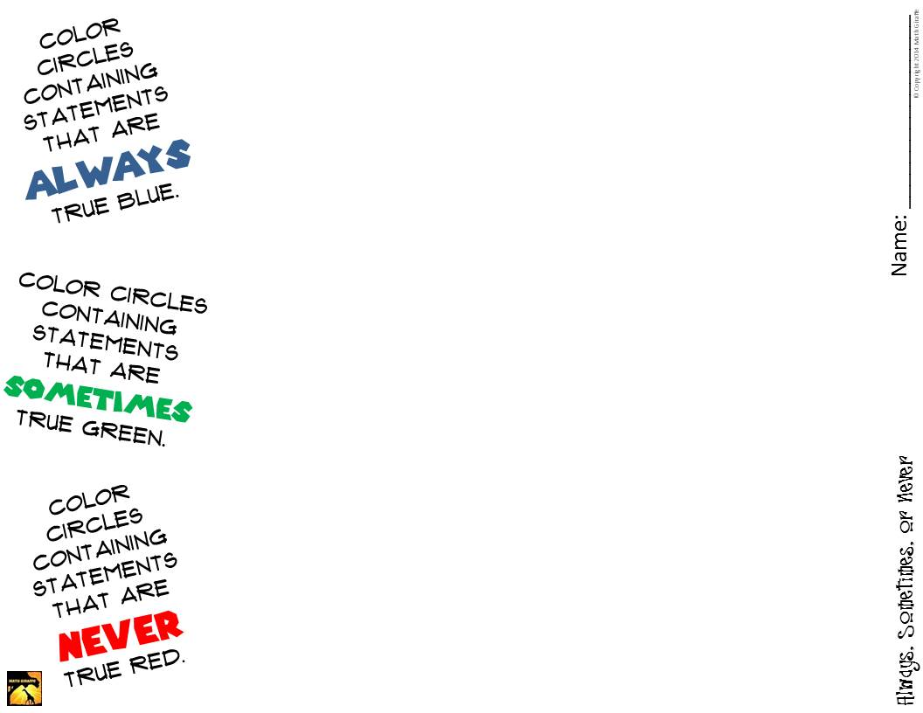
statement
statement
statement
statement
statement
statement
statement
statement
statement
statement
statement
statement
statement
statement
statement
statement
statement
statement
statement
statement
statement
statement
statement
statement
statement
statement
statement
statement
statement
statement
statement
statement
statement
statement
statement
statement

Slide 5
